Slide 1
CHURCH DISASTER RESPONSE COORDINATORS
FUNCTIONS & RESPONSIBILITIES

Slide 2
WHY HAVE A COORDINATOR?
Disasters are local – need initial local response
Prior planning is essential
Local coordinator usually in best position to initially assess the situation and report
Local coordinator knows the “lay of the land”
If local church and presbytery are overwhelmed MNA can lend support or lead effort

Slide 3
WHAT WOULD A COORDINATOR DO?
Work with us to customize duties
Assess the church’s capabilities to provide volunteers, supplies and equipment, finances, and facilities
Point of contact
Solicit volunteers, gather supplies and equipment, & dispatch team(s)
Promote disaster preparedness in the church
Could also promote church security & emergency response

Slide 4
WHO SHOULD BE A COORDINATOR?
Someone with
  A heart for mercy ministry
  Good organizational skills
  Good communicator
Could be someone who organizes but doesn’t actually deploy
May be a deacon but it’s not a requirement
Construction skills would be a plus

Slide 5
WHAT IS THE
TYPICAL SEQUENCE OF EVENTS?
Coordinator reports damage and whether help is needed
If a regional disaster, NTP Subcommittee calls for presbytery-wide assistance – coordinates volunteers and solicits funds.
If the damage is excessive, we notify MNA and request assistance
MNA sends Assessment team and, if necessary, sends First Responder team, arranges for site manager, coordinates volunteers, & raises funds

Slide 6
WHO SHOULD I RECRUIT
AS VOLUNTEERS?
Heart for service
Trainable or with a needed set of skills
Can respond quickly
Reliable
Those you can vouch for
Men, women, older teens

Slide 7
ARE THERE VOLUNTEERS
WE DON’T WANT?
Don’t show up uninvited!
  Unaffiliated or spontaneous volunteers a national problem
  Mostly untrained, unskilled or ill-equipped
  Unknown quantity – credentialing
  Temptation to accept
  Many times end up draining resources
Not talking about your church members showing up

Slide 8
HOW DO I
TRAIN & RETAIN VOLUNTEERS?
Develop training
Send to CERT or Red Cross courses
Take online courses
Form “peacetime” teams for
  Church maintenance
  Helping widows, the elderly or homebound
  Outreach mercy ministry around the neighborhood

Slide 9
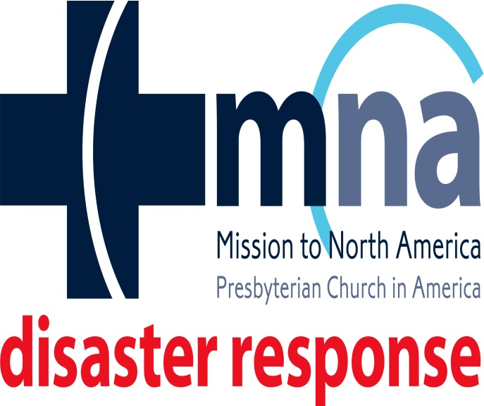
CONTACT
Rick Lenz, MNA South Central Region Disaster Response Specialist
Serving OK & TX
Mobile: 817-690-8107
Home: 817-361-9265
www.disasterresponseoktx.com
at MNA South Central Disaster Response Region
at rlenzmna

